Slide 1
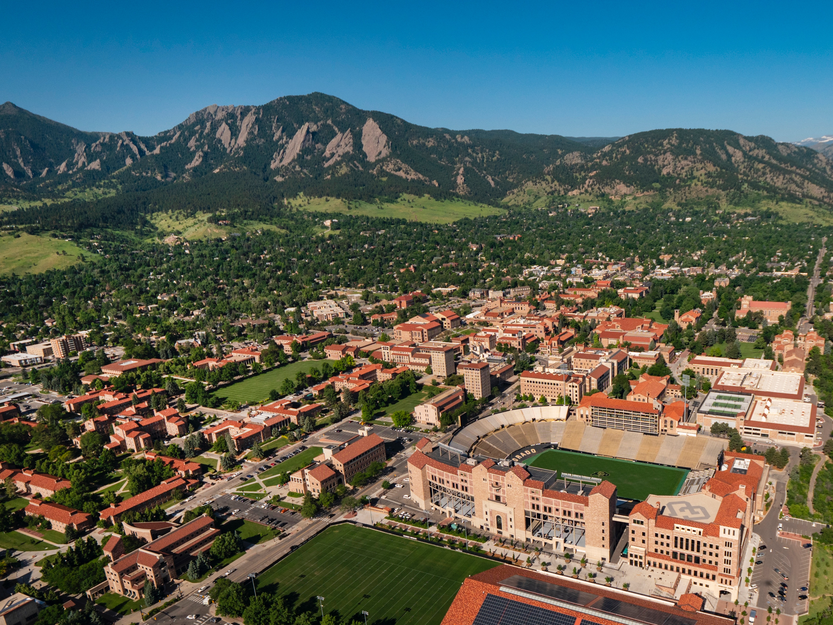

Predicting Future Sales
Machine Learning Final Project
Summer 2022

Slide 2
Problem Statement
"You are provided with daily historical sales data. The task is to forecast the total amount of products sold in every shop for the test set. Note that the list of shops and products slightly changes every month. Creating a robust model that can handle such situations is part of the challenge." *(src: competition page)*
Live Green

Slide 3
Complications with Domain
Software sales spike on new software
New items are added semi frequently
Test data includes items that do not exist in training data
There are both seasonal spikes and spikes due to new releases

Slide 4
Description of Data
File descriptions
sales_train.csv - the training set. Daily historical data from January 2013 to October 2015.
test.csv - the test set. You need to forecast the sales for these shops and products for November 2015.
sample_submission.csv - a sample submission file in the correct format.
items.csv - supplemental information about the items/products.
item_categories.csv - supplemental information about the items categories.
shops.csv- supplemental information about the shops.
Data fields
ID - an Id that represents a (Shop, Item) tuple within the test set
shop_id - unique identifier of a shop
item_id - unique identifier of a product
item_category_id - unique identifier of item category
item_cnt_day - number of products sold. You are predicting a monthly amount of this measure
item_price - current price of an item
date - date in format dd/mm/yyyy
date_block_num - a consecutive month number, used for convenience. January 2013 is 0, February 2013 is 1,..., October 2015 is 33
item_name - name of item
shop_name - name of shop
item_category_name - name of item category
*(from competition description)*

Slide 5
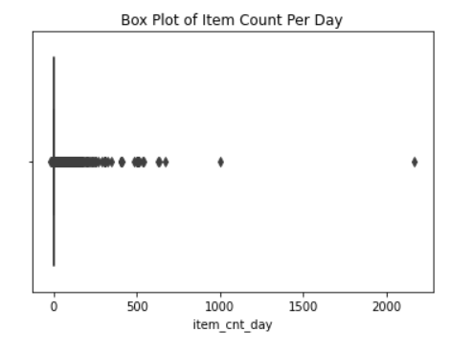
Exploratory Data Analysis

Slide 6
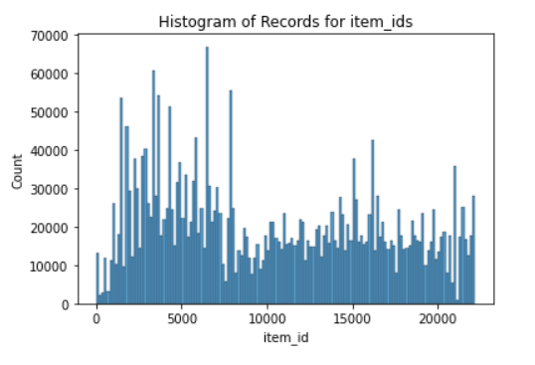
Exploratory Data Analysis

Slide 7
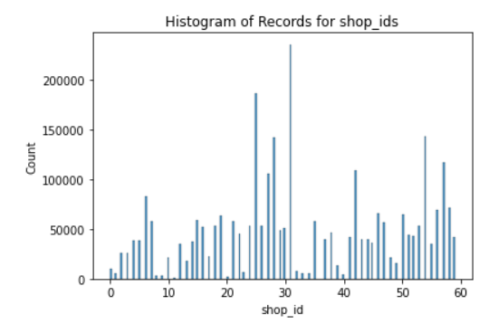
Exploratory Data Analysis

Slide 8
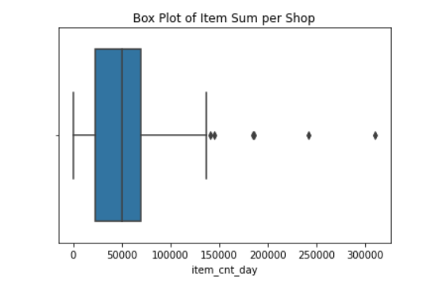
Exploratory Data Analysis

Slide 9
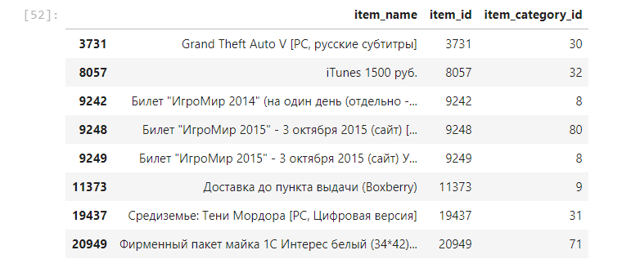
Exploratory Data Analysis

Slide 10
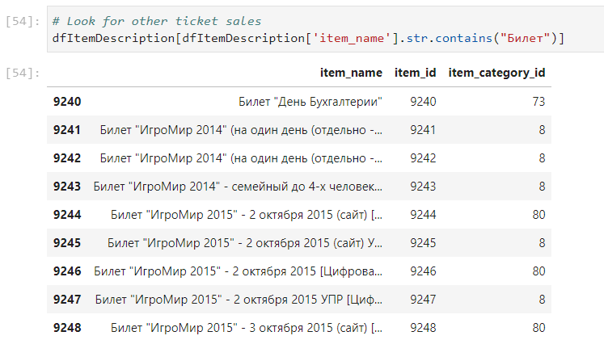
Exploratory Data Analysis
Notes:
We see a few different categories with tickets.
When we look them up in the item category table we see that in this example, 8 is ticket and 80 is services ticket
The category 73 that is a one off is in the category “Gifts – Figurines”

Slide 11
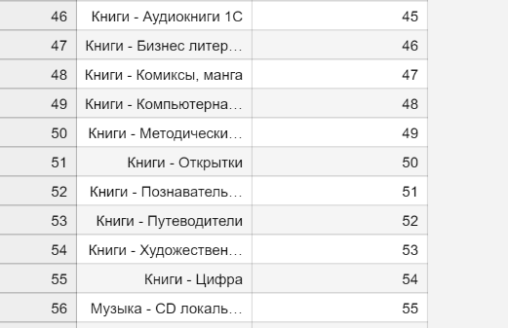
Exploratory Data Analysis
Notes:
This screenshot focuses on different categories of books and we can see music in here also
There are similar categories for games and accessories for different platforms.

Slide 12
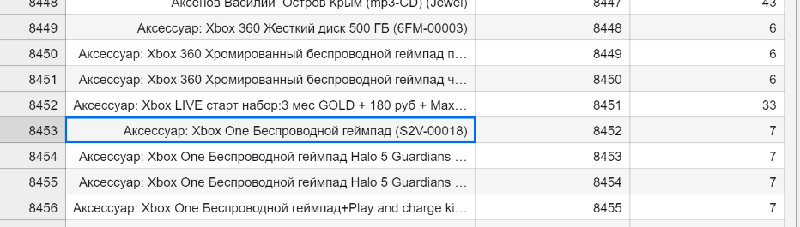
Exploratory Data Analysis

Slide 13
Methods Evaluated
Matrix Factorization
Multiple Linear Regression
LSTM Neural Network
Temporal Clustering
Notes:
I also considered a Hidden Markov Model to look at temporal trends but sklearn deprecated the functions and time constraints made it impractical to implement

Slide 14
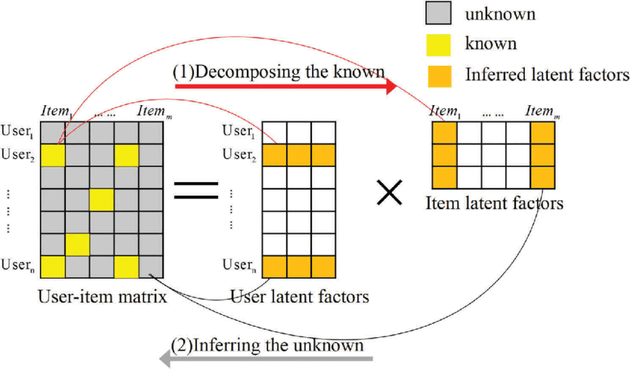
Matrix Factorization Overview
Starts with a matrix including unknowns
Decomposes the matrix to find latent factors
Infers unknown data
Source in speaker notes
Notes:
Image source: https://www.researchgate.net/figure/Diagram-of-matrix-factorization_fig1_321344494

Slide 15
Matrix Factorization Implementation
Set Up
Created a matrix of all items and shops in the training data
If an item and shop was not present in a month, assumed 0 of the items were sold
Issues
Some items in the test data not present in the training data
Temporal relationship was not established
Future Work
Add columns to track monthly sales for the next month
Add columns to track categories of items
Add columns to track cluster of shops
Notes:
RMSE on test data was 0.945051033607905
This is a good result.
Additional engineering is needed to put data in format

Slide 16
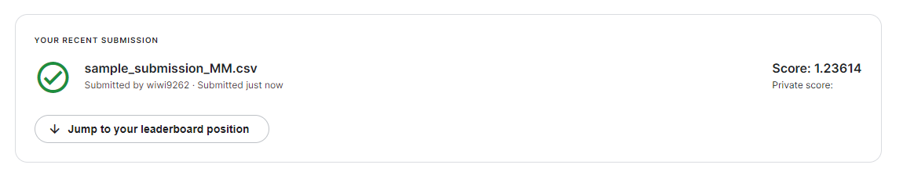
Matrix Factorization Results
Test Data RMSE: 0.945
Kaggle Results: 1.236

Slide 17
Multiple Linear Regression
Set Up
Use month number, item_id, shop_id, and current month sales data as independent variables
Use next month sales data as target
Issues
Item_id and shop_id and numeric but they are really categorical
Making dummy variables for the categories does not scale well
Future Work
Add dummy variables for item categories
Add dummy variable for clusters of shops

Slide 18
Temporal Clustering
I initially looked at temporal clustering to group similar items to estimate sales data based on the cluster
The initial results were not as promising as LSTM
After evaluating the shortcomings of the LSTM model, I see opportunities to use clustering on categories of items and shops to find temporal trends

Slide 19
Long Short Term Memory Network
Set Up
Two LSTM Layers
Issues
Resource Heavy
Future Work
Additional Feature Engineering
One Dense Layer
Long Training Time
Deeper Network
More Epochs

Slide 20
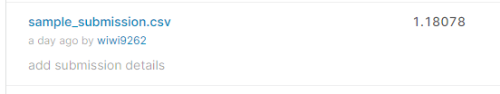
LSTM Results
Test Data RMSE: 1.257
Kaggle Results: 1.181
Notes:
1.257

Slide 21
Analysis of Results
What went well
The general idea of the LSTM and Matrix Factorization models showed promise for this problem
The scaled RMSE on the training data was very low
The RMSE of both the LSTM and Matrix multiplication models were good

Slide 22
Analysis of Results
What can be improved
A deeper network would improve performance
Using more epochs could improve performance. We limited our model to 20 epochs and used an early stop to cut that off if loss didn't improve in 3 epochs
The biggest issue is with feature value clustering and imputing values
We could improve the model by using unsupervised techniques to cluster items and shops
The items include categories that have some value but we need additional clustering

Slide 23
Analysis of Results
What can be improved (cont)
The item clusters are things such as Games - Xbox, Accessories - Xbox, Games - PS4 and various book, music, and video categories
These could help with imputing missing values in the test and training data
An issue with this type of data is that many of these items come out on a certain date, have a spike, then fade
To properly trend items we need to track trends on a few axis
Some of this could include natural language processing.
For example, if we have data on the sales for the release month of 2 different Call of Duty games and we have new Call of Duty game in the test data, we can assume it will have similar results
In another example, if the release date of a game on Xbox was in November but was in December for PS4, we could use the Xbox data, scaled by platform popularity to estimate the value for the PS4 version.

Slide 24
Future Work
The main thrusts for future work are:
Add addition feature engineering by clustering similar items using NLP
Create deep models for LSTM

